Slide 1
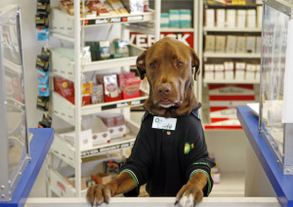
At the gas station-convenience store at the intersection of Nursery Road and U.S. 19 in Clearwater, clerk Cody, the chocolate Lab wearing a shirt with a BP tag, greets the customers.

